Slide 1
Genealogy on the Go ……..
Going mobile and taking advantage of today’s technology as you research on the Go…
Presented by: Larry Patrick
larrypatrick@jacksoncountyohiogen.com

Slide 2
Going mobile….
What does mobile mean to you?

Slide 3
Going mobile…. What does mobile mean to you?
1980 through 1990’s
Notepads, pencil and pens
Camera
Maps
Cassette Recorder
Research notes / data sheets
Trips to the courthouse, libraries and cemeteries
Genealogical and history narratives / books.
During the 1990’s computers were introduced along with software and by late 1990’s the internet.

Slide 4
Going mobile…. What does mobile mean to you?
2000 to Present
Virtually everybody has a computer in their household and they are on the internet.
Virtually everybody doing research, are in some way maintaining their research using a computer.
Scanners and digital cameras
Many resources are online and easily accessible.
Information can be obtained via email, PDF download or by messaging.
In addition there are many avenues to obtain information from around the world through mailing lists, forums, message boards and social media.

Slide 5
Going mobile…. What does mobile mean to you?
Genealogy research in the future….
Abundance of online resources (Ancestry.com & FamilySearch.org)
Geo Tagging documents and photos
Virtual Cemeteries (LifeMarker & AR)
DNA (Ancestry.com / DNA)
Family Histories will be shared with all members of the family
Genealogical Software Apps
Genealogical Software Sync (Online)
Google Goggles
Google Glasses (AR - Augmented Reality)

Slide 6
Google Goggles

Slide 7
Augmented Reality Today (WikiTude)

Slide 8
Future of Augmented Reality

Slide 9
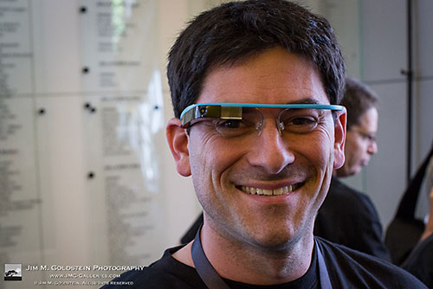
Going mobile…. What does mobile mean to you?
Google Glasses

Slide 10
Google Glasses

Slide 11
Going mobile…. What does mobile mean to you?
What are some of the technological tools being used today to do research?
Desktop / Laptop / Netbook Computers
Tablets
Smartphones
Digital cameras and scanners (mobile)
Mobile Storage Devices (Flash Drives / “The Cloud”)

Slide 12
Going mobile…. What does mobile mean to you?
What is “Cloud Storage”?
Cloud Storage is a model of networked online storage where data is stored on multiple virtual servers, so that you can save your data in different servers and then get access to it from the one nearest to you, wherever you are.

Slide 13
Going mobile…. What does mobile mean to you?
What is “Cloud Computing”?
Cloud computing is the delivery of computing and storage capacity as a service to a community of end-recipients.

Slide 14
Going mobile…. What does mobile mean to you?
What is “The Cloud ?
Internet based services
Upload notes and scanned photos
Upload images and files
Upload reference materials
Automatically available on desktop and other devices.

Slide 15
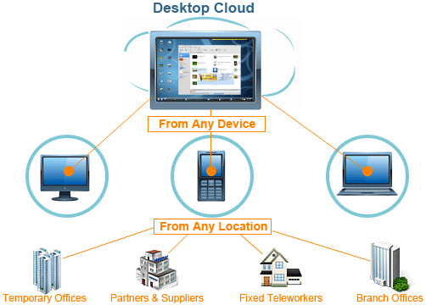
Going mobile…. What does mobile mean to you?

Slide 16
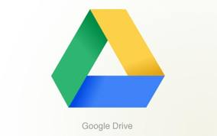
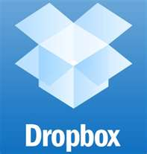
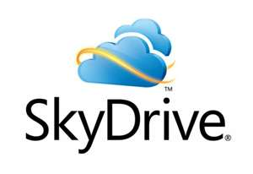
Going mobile…. What does mobile mean to you?

Slide 17
SugarSync

Slide 18
Going mobile…. What does mobile mean to you?
Whichever cloud storage service you choose to use, you need to install its software in your computer and devices to sync and back up your files automatically or manually, and then you can get access to your backup files wherever you are.

Slide 19
Going mobile…. What does mobile mean to you?
Questions & Answers
Product Demo

